Slide 1
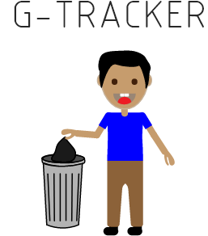
COEN/ELEC 390
G-Tracker
Prepared By:
Team 3
Mohammed Al-Taie
Paul Westenberg
Erfan Reza
Saro Nokhoudian
Rifadul Haque
Jean Mardini

Slide 2
Case Scenario
-Task to change all full garbages in a building
-Need to verify every bin! -> Very time consuming
-Is there a way to know in advance which garbage is full?

Slide 3
Project Description / How it works
-Make an account
-Input in app which garbage you want to track (using a specific bin code)
-Observe changing garbage fullness on app
Our Goals:
-Help the cleaning staff to work efficiently
-Save workers time

Slide 4
Target Market
-The initial idea: For Concordia cleaning staff (in areas such as
Concordia Library and Hall Building)
-Eventually expand to hospitals, school, households, etc.
-Any corporation that interested in controlling their bins and avoiding overflows
-Possibility to expand to outside bins/containers(such as for the City of Montreal

Slide 5
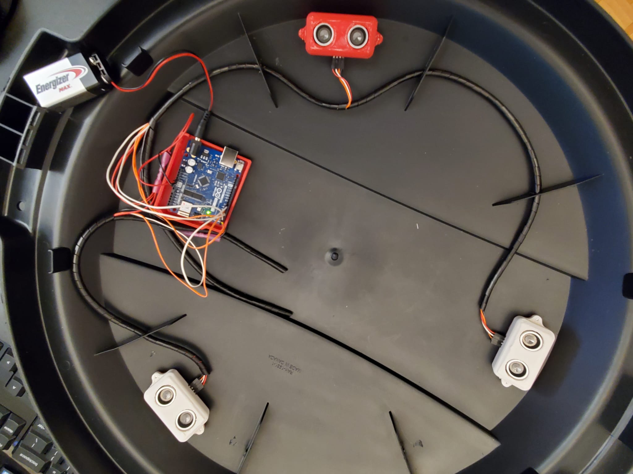
Hardware Overview
The hardware components of the G-Tracker are as follows:
An Arduino Uno microcontroller.
Three ultrasonic sensors.
Connecting wires.
A battery.
The enclosures.
Notes:
Script can be added here if needed to talk thoroughly about the hardware components (depends on time availability)

Slide 6
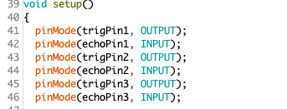
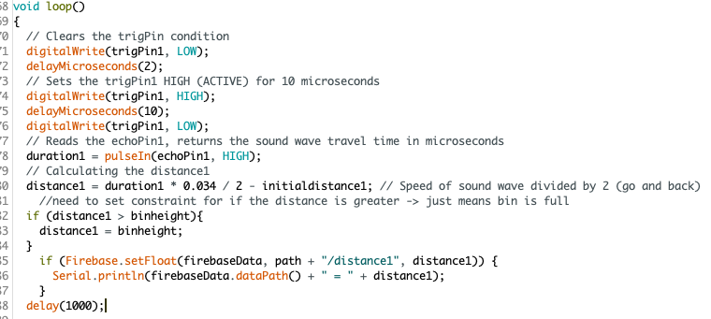
Software Component (Arduino)
Setting the pins of the sensors:
Steps to retrieving distance:
-Set trig pin to high
-Set echo pin to high and get time that it took
-Calculate distance
-Send distance to firebase

Slide 7


Software Component (Arduino)
Get Average distance of 3 sensors:
Get the estimated fullness of bin:
Send both of the information to Firebase Real Time

Slide 8
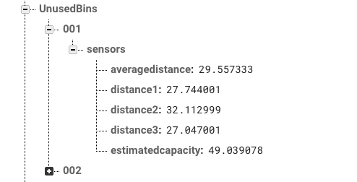
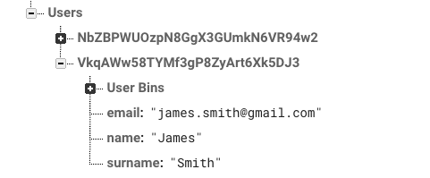
Software Component (Firebase)
UnusedBins:
-Each child is the bin code
-Where arduino sends information
Users:
-Each child is the user’s hash
-Contains user’s email, name, surname as well as his user bins
-Associated with firebase authentication

Slide 9
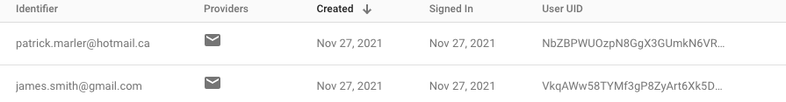
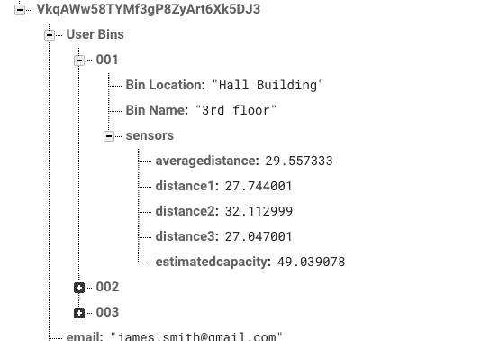
Software Component (Firebase)
Firebase Authentication:
User Bins:
-Each child is a bin code
-Contains user inputted info, location and name
-Contains the sensor values associated with that bin code in UnusedBins reference

Slide 10
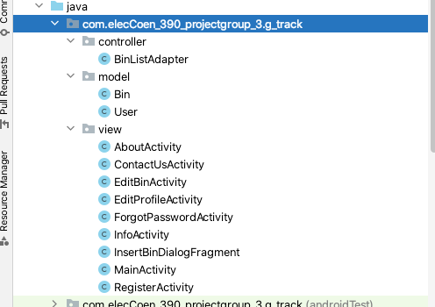
Software Component (app)
Android Studio:
Controller ->
Model ->
View ->

Slide 11
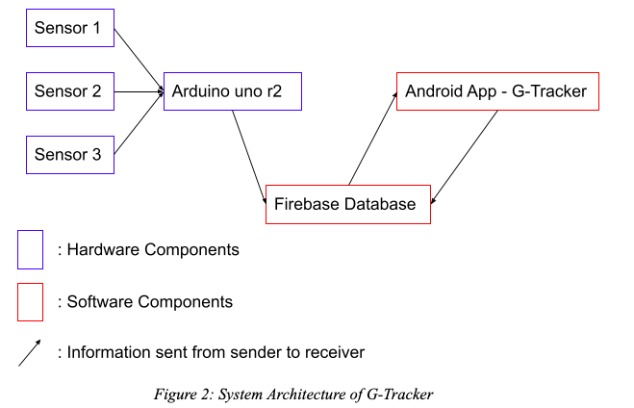
Communication

Slide 12
What to improve? (Hardware)
We aim on improving the future versions of our product by attempting to solve some of the issues we are currently aware of:
Power
Experimental value with power consumption with our system stand up to 2 days and 20 hours. In future, we are aiming for this system to go upto a month.
Design
We are using three ultrasonic sensors now, however we can reduce the number of sensor two instead of three.
Notes:
Power:
We are aware that it would be difficult to replace the batteries of our product repeatedly and specially when we’re expecting our device to be implemented across many bins. A solution we’re considering is to equip our device with a solar panel that can charge the battery. Many factors will be implicated with that solution in terms of cost and feasibility so our solution is still understudy.
Design:
Our device is intended to be installed inside the bin cover where garbage can be monitored from the top. To achieve our target of spreading the product across more industries, we need to redesign the product in a way the components are closely interconnected inside one enclosure. Ultimately, we want our device to be installed on the bin in a matter of seconds as oppose to having to place each of the sensors and the device in a specific location inside the bin lid.

Slide 13
What to improve (Software)
Software components and modifications that can be applied in future upgrades of the device:
QR scan for bin code
Install a bluetooth chip so the user can input his wifi id and password (instead of manually entering in the arduino)
Modify arduino to send information every 5-10 minutes

Slide 14
Business Model
Cost of a single bin: 3sensors*2.80$ + 1arduino*59.99$ +wires 4$+1(bin) 19.99$ = 92.40$
Rent the bins for 19.99$ a bin a month (or 200$ a year)
Is it worth it for the buyer (the company)?
-If you pay an employee about 20$ an hour
-The devices (say 15 bins) save them 3 hours a day, 60$ saved a day, 1200$ a month
-The cost of the 15 bins would be 15*20$=300$ leaving you with 900$ profit

Slide 15
Future Expansions Of Our Company/Product
Sell the attachment separately (user should be able to enter his/her bin height)
Important to expand to outside bins (comes with challenges such as cold, snow, vandalism...)
Optimise routes for the workers
Need to recreate the app in appstore (iphone)

Slide 16
Concordia Funding
Christine Dy, Developper Officer, Affinity and Community Programs at Concordia
Demo done on November 21st. FundOne: Not what we were looking for.
Faisal Shennib, M.Eng, Environmental Specialist at Concordia University
Demo done on November 29th, Really liked our product.
Potential of 2000-5000$ fund to implement some bins inside Concordia.

Slide 17
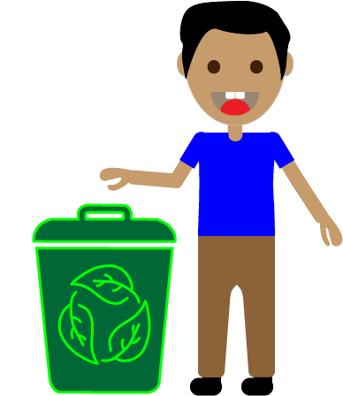
Thank you!

Slide 18
Questions?

